Slide 1
RE
Lense 3
The life of Jesus

Slide 2
The Epiphany
The Feast of the Epiphany The Feast of the Epiphany celebrates the visit of the wise men to the child Jesus. It celebrated on January 6. The word epiphany means ‘manifestation’ or ‘sudden realisation’. The Feast of the Epiphany therefore celebrates the display of God’s love and power in the person of Jesus. It is an ancient festival, recorded by some of the Church Fathers as early as the 3rd century. The early Church it celebrated four ‘manifestations’ of God; the birth of Jesus, the visit of the wise men, the Baptism of Jesus and the miracle at Cana! Eventually each of these festivals came to be remembered on a different day. The Feast of the Epiphany today only remembers the visit of the wise men, however, it proclaims and reminds us that God came among us and this should change the way we see things and act. ‘The Feast of the Epiphany is not an ancient version of Halley's comet. It is about how God's glory changes human hearts.’ Fr Richard Leonard

Slide 3
Create Stars for the wise men followed
Stars! The wise men follow a star. Make as many of all types as you can. In playdough, bread dough, stained glass (cellophane). Vocab of distance: a long way, close, steps, near, far,
Tradition says that the Wise men travelled across the middle east – possibly Iraq and stopping to buy their gifts in Petra where there were markets. Use maps (or the pupils own backgrounds) to contextualise the passage. See links/map in resources.
Look at the resources what would the journey be like?
Add crowns to small world.

Slide 4
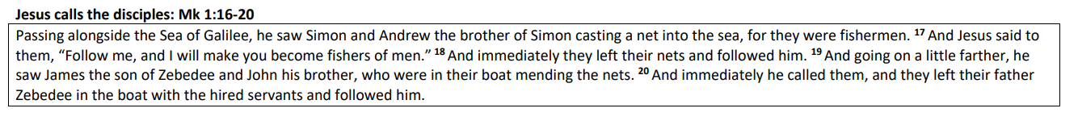
Wondering Wall I wonder…
If you would like to be a disciple of Jesus?
I wonder…how you like to be treated?

Slide 5
Focus Question 1: What does the Church say about Jesus’ life?
Wonder wall
I wonder…who you like to visit? I wonder…who do you like visiting you ?
Jesus welcomes children – how do we respond to situations of conflict?

Slide 6
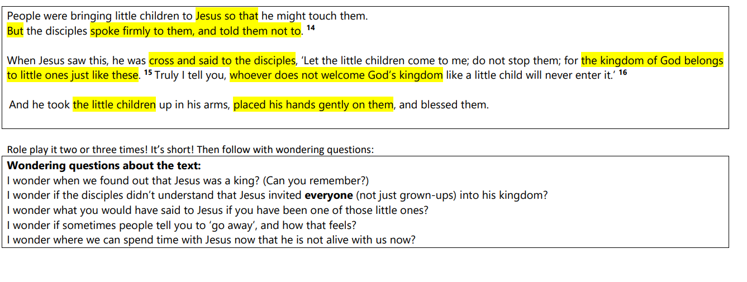
Jesus welcomes the children. Mk 10: 13-16

Slide 7
Monday 22nd January
How can we welcome Jesus?
Talk about how we welcome people with appropriate touching –…hand shake, high five, hug
What happens when we don’t want to meet someone?
Use dialogue in text to explore ways of saying ‘no, stop that’ don’t do that’.

Slide 8
Have a picnic with Jesus?
What would we ask him?
Invite Father Stamp

Slide 9
Feeding of 5000 Mk 6:31-42
During a Mass
The similarity between the actions of Jesus and the actions of our Priests have previously been made (Hear Lens). This text, which models the Eucharist (gathering; talking and listening; blessing, breaking and giving of bread; departure) brings the seeds of the Mass back to the centre of Jesus life
When we gather as one in Mass we take the bread and take a part of Jesus
To remember he is always with us
Finish with the Glory be prayer
The Glory Be “Glory be to the Father and to the Son and to the Holy Spirit. As it was in the beginning, is now, and ever shall be, world without end, Amen” The prayer is a short prayer of praise to God – sometimes called a doxology. The response (As it was in the beginning…) speak of God’s presence always!

Slide 10
Jesus blesses the food and there is enough for everyone – we call this story a miracle story because something strange and unusual happens. It reminds us that Jesus is God!
Listen to the story with props.

Slide 11
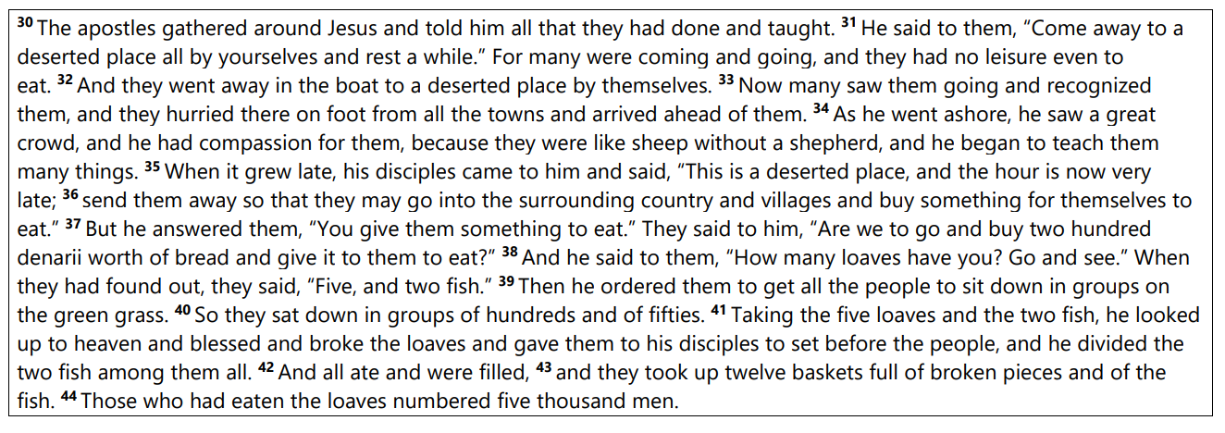
Feeding of 5000 Mk 6:31-42

Slide 12
Re-enact the story of feeding the 5000

Slide 13
What do Catholics believe about the life of Jesus?
We are the seeds of God.
Let’s plant them and help them grow?
Jesus is God’s son who came to show God’s love to all people.
What ingredients do we need to make sure it grows in kindness?

Slide 14
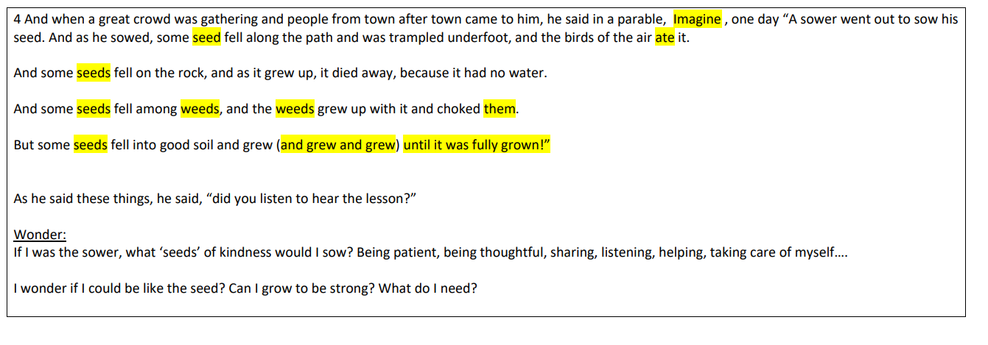
Parable of the sower: Lk 8:4-8 This is a story that Jesus TOLD (a parable) – Jesus wanted to teach people something, so the pupils need to listen for the message. Use your sand tray to tell the story – do as you speak! Vovab: Sower – a man who sowed (planted seed) – model/role play it – throwing the seeds onto the field.
Parable of the sower: Lk 8:4-8

Slide 15
How can we be friends of Jesus in our lives?
We LIVE We welcome and show love to everyone i n our words and actions – just as Jesus does. We are [especially] called to help the poor and hungry.
Can we be God’s ears, eyes, lips, hands and feet? Use images of these body parts for children to colour and write how they can treat others as they like to be treated and bring God’s love and care to everybody.

Slide 16
The Golden Rule Mt 7:12
The Golden Rule: (Treat others as you like to be treated) Mt 7:12 This is a single teaching from the Sermon on the Mount. Jesus sits beside Lake Galilee and gives a really long day of lessons…one of them it this one. It’s a saying - so you don’t need to act it out…just tell them! It’s a rule!
Create Act like Jesus posters
Mt 7:12

